Slide 1
Stock Market Time Travel:
A game randomizing historical stock returns for fun & stock trading practice
Opening Screen

Slide 2
Rules:
Use your fake $100 to buy shares of the stocks offered
Push the arrow by the randomized year to take a journey to the returns from a randomized year from the 2000
Rinse & Repeat
2nd Screen

Slide 3
Pro Tips:
History tends to repeat itself, but does not always
There will be ups & downs
This is based on historical data, but all data is flawed
Only invest what you can afford to lose
Have some FUN
3rd Screen

Slide 4











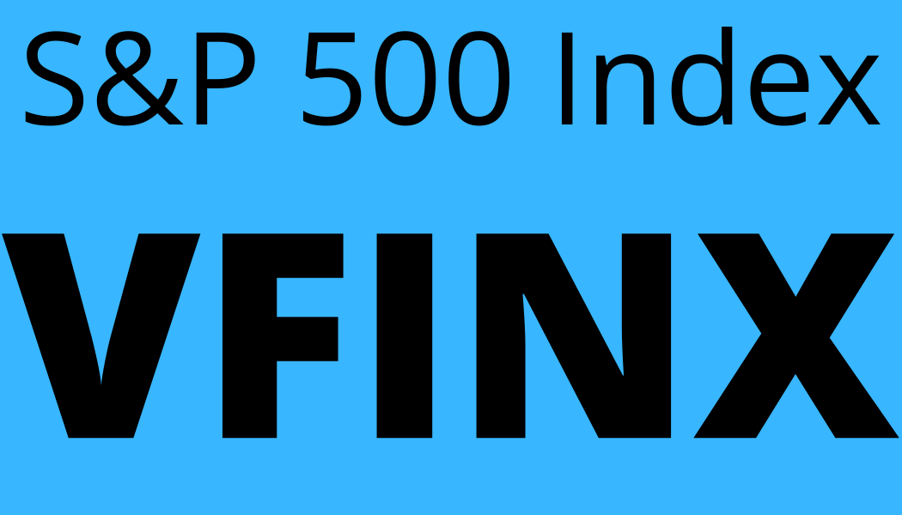

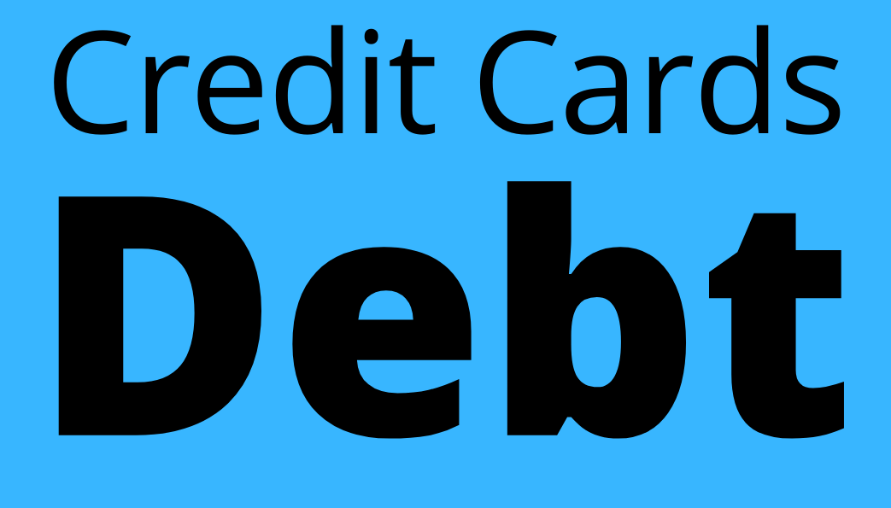
Cash
Investments
$100
$0
Misspelled
Year:
0
0%
0%
0%
Next screen is if you click on this button
0%
0%
0%
0%
0%
0%
0%
0%
0%
0%

Slide 5
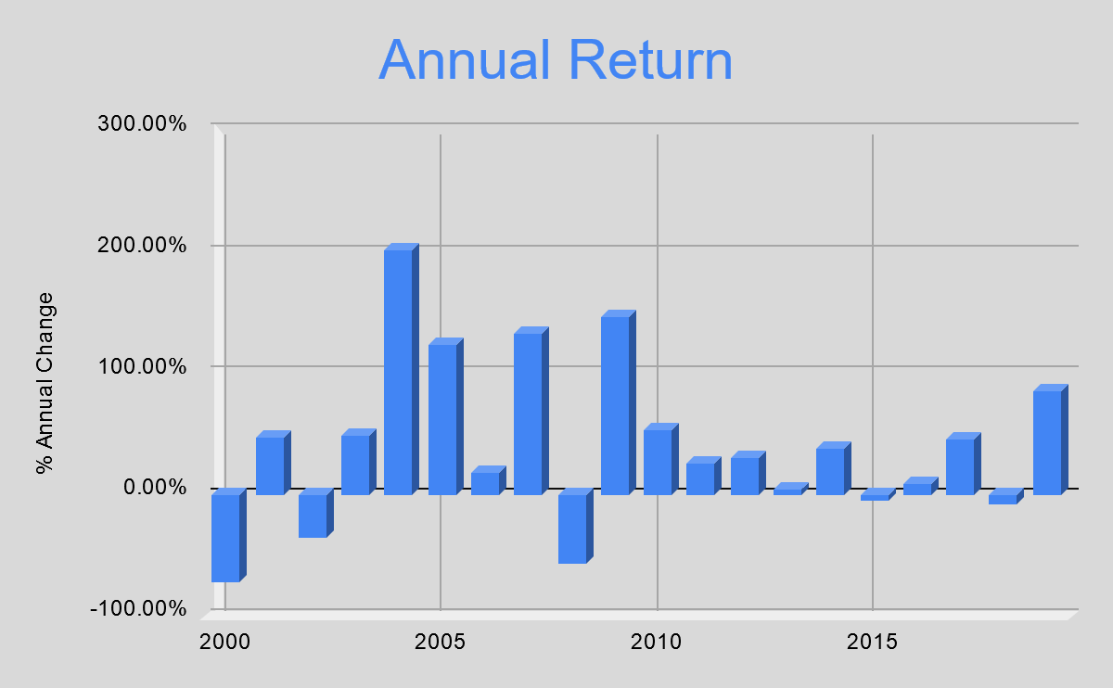
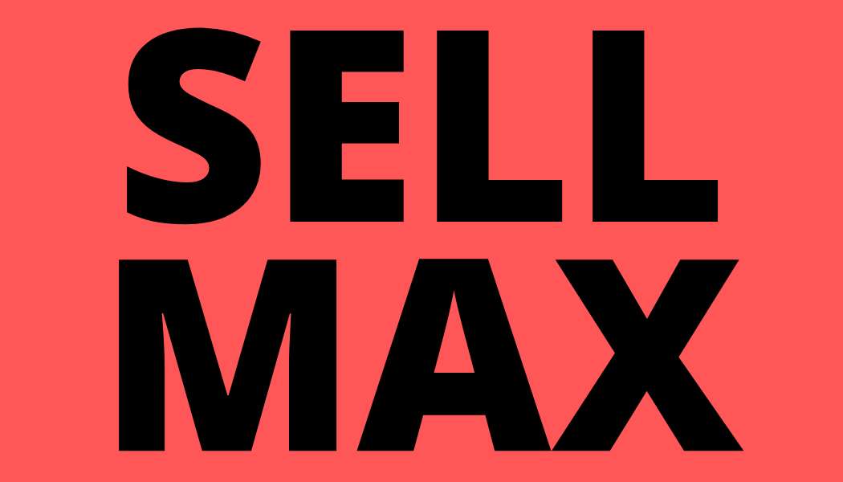



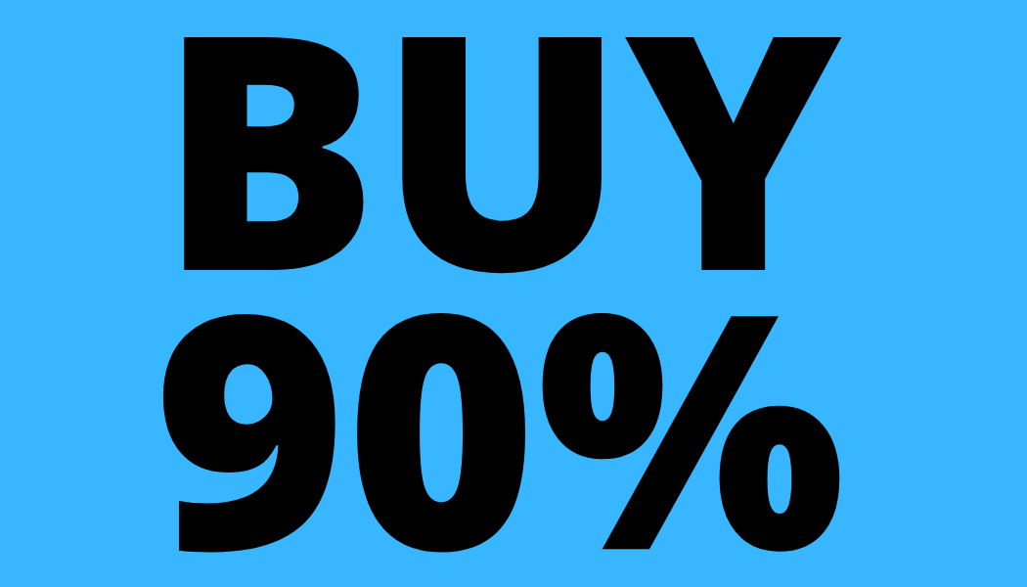
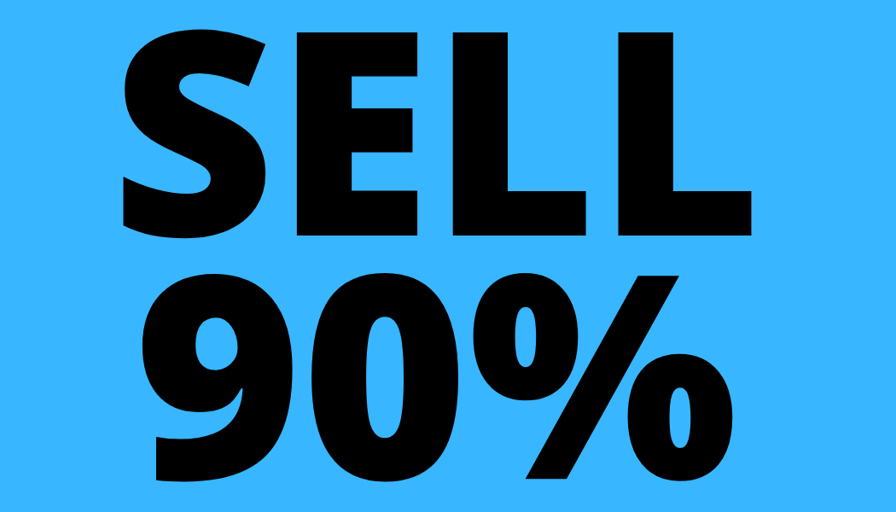

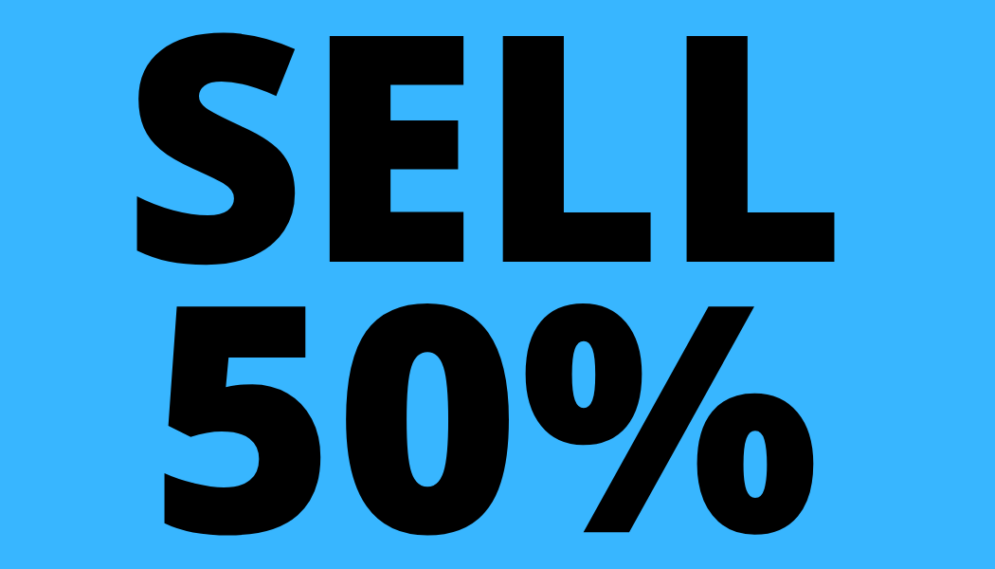

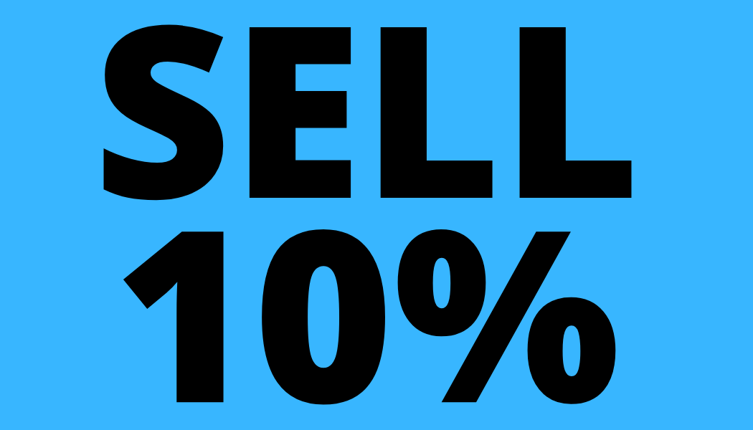
Cash
Investments
Click to return to the previous screen
$100
$0
Or click one of these buy buttons to spend your cash. Clicking on a buy or sell button will bring you to the next screen, which will reflect your purchase or sell
Other colors the SELL buttons could be

Slide 6
Cash
Investments
Amounts changed due to purchase
$0
$100
Tap to move to advance to a random year & that year’s returns/losses
Year:
0
0%
0%
0%
0%
0%
0%
0%
0%
0%
0%
0%
0%
0%

Slide 7
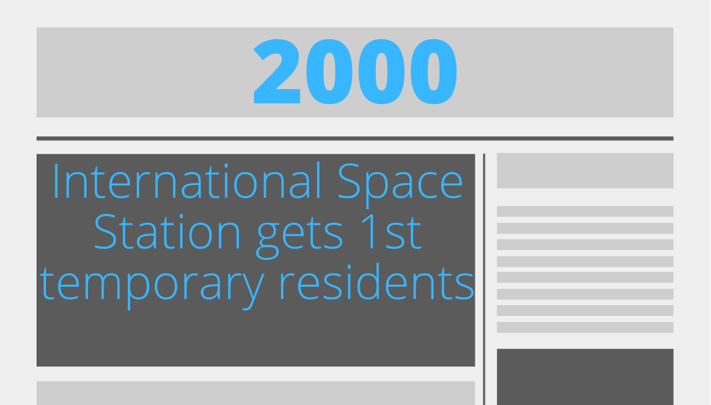
Cash
Investments
Date & news changed, but since the game randomly picks years, it could be the same year. If it were the same year, then the player would still experience the gains or loss % of that year
Could have like 20 different news items for each year, so 400 different randomly picked news headlines possible
$0
$28.95
Year:
1
Years invested changed due advancing
0%
0%
0%
The top 4 do not change as they are grayed out as they need to be bought with real money or earned in game. Could be grayed out. Also these stocks do not have data for early years, like this, so they would be 0% when 2000 appears regardless
0%
-71.05%
-79.56%
-62.84%
-26.96%
-62.84%
-20.05%
-9.06%
4.93%
-14.91%

Slide 8
Brainstorming
5 Lessons
1. Don’t invest money you cannot afford to lose
2. Don’t invest in things you don’t understand, but also don’t wait for the perfect choice, just make a quality choice with investing
3. Warren Buffet "A low-cost index fund is the most sensible equity investment for the great majority of investors,"
4. If you don’t believe a man who has been the richest in the world, then take Jack Ryan’s word, "The secret is to get yourself a really good S&P 500 Index fund”
5. This is game, so you don’t need to follow the rules. Have fun & learn from no cost mistakes
In Game Lessons
Index Funds are made of parts of many other stocks, so all the companies would have to go out of business for you to lose all your money
Index Funds can be made of garbage, just because it is a fund or indexed does not make it good
Index Funds are often low cost, but not all are
Index Funds that track the broad stock market, like a S&P 500 fund in the game, historically always gain more money in the long-term than many other investments, including CDs, bank accounts, & most stocks
Index Funds are not something you need to completely understand before investing into
This game only uses companies that have not declared bankruptcy
Individual stocks can lose you all your investment, as those companies can go out of business
It is highly illegal to trade stocks or funds based on information only company insiders should know

Slide 9
Rules
-Pick your investments
-Advancing will bring you to a randomized year of performance returns
CD gains taxed at your normal income tax rate
Stocks & funds held less than a year taxed at your normal income tax rate
Stocks & funds held more than a year taxed 0%, 15%, or 20% (https://www.nerdwallet.com/blog/taxes/capital-gains-tax-rates/)

